Slide 1
What Is Calsavers ?
April 2022

Slide 2
CalSavers is a new automatic enrollment payroll deduction IRA savings program for private sector workers whose employers do not offer a retirement plan. This program gives employers an easy way to help their employees start, seed and grow a savings for retirement, with no employer fees, no fiduciary liability, and minimal employer responsibilities.
What is CalSavers?
https://edd.ca.gov/en/employers/calsavers#:~:text=CalSavers%20is%20a%20retirement%20savings,liability%2C%20and%20minimal%20employer%20responsibilities

Slide 3
The CalSavers Retirement Savings Program was created by state law to ensure all California workers can save for retirement through automatic payroll contributions facilitated from their workplace. CalSavers was established (2016) in state law to address the growing retirement savings gap that will occur for many residents in the future and was created to support employees while also being designed to be as easy as possible for employers.
https://employer.calsavers.com/

Slide 4
PROS
Easy Facilitation
Employers serve a limited role: facilitate the program by adding and maintaining their employee roster and submitting contributions via simple payroll deduction.
No Employer Fees
There are no employer fees or fiduciary liabilities and employers do not make contributions to employee accounts.
Great Way to Save
As the employer, you won’t have to spend anything -- CalSavers is entirely free for Employers to use.
As the employee, it is entirely up to them on exactly what they would like to save and exactly what they would like to contribute.
Easy Access
Setting up your account is quick and easy! Savers can manage their account online, by phone, or using the CalSavers Mobile App.
Employees can also opt out and back in anytime.
Ongoing Support
The savers account is a Roth IRA (after tax) that is set up in their name with a default savings rate of 5% of gross pay.
(Savers can recharacterize to a traditional IRA and change rate at any time.)
The savers account is portable, and it stays with them even if they leave the workplace. If an employee changes employers, their contributions will remain in their account. The saver can contribute to it independent of an employer.
Need Guided Support? Click Here!

Slide 5
CONS
No Follow up Required by Employers
Specific Deadline Parameters
Employers are not responsible for answering questions about the program, managing investment options, processing distributions, or giving investment/tax advice.
Mandated employers must register before their state deadline. The three-year phased rollout includes staggered deadlines for registration based on employer size. Employers who do not fulfill their responsibilities by the specified deadline dates are subject to enforcement action which will include financial penalties. (i.e., Non-compliance.)
Employee Dependent Maintenance
Employer Non-Compliance Penalty
Employees will maintain their account directly through the CalSavers program.
Employees will have to pay an administration fee, taken from the assets in their accounts.
Depending on the investment program they choose, they will pay an annual fee of between 0.825% and 0.95% or approximately $0.83 to $0.95 for every $100 in their account.
Per Government Code Section 100033(b), each eligible employer that, without good cause, fails to allow its eligible employees to participate in CalSavers, on or before 90 days after service of notice of its failure to comply, shall pay a penalty of $250 per eligible employee if noncompliance extends 90 days or more after the notice, and if found to be in noncompliance 180 days or more after the notice, an additional penalty of $500 per eligible employee.

Slide 6
Employer Steps
Watch This Video
Determine Mandate Status: Not all employers are required to participate. Only employers who do not sponsor a retirement plan and have 5 or more California employees must join CalSavers.
Register your company through the CalSavers website. The sooner you register, the sooner your employees can start saving!
Submit to Employee Listing To CalSavers including: Name, SSN, Birth date, Email, Mailing address, Phone number
Begin Deductions for all employees 30-days later. All are automatically enrolled with an after-tax Roth deferral of 5% of pay unless they elect a different rate or opt out. Deferrals increase by 1% of pay each year up to a maximum of 8% of pay.
Remit Contributions after each pay period to CalSavers in an acceptable file format.

Slide 7
Employee Steps
Watch This Video
Register and/or Set up your account online through the CalSavers website by registering here!
Remit Contributions after each pay period to CalSavers.

Slide 8
FEATURES
Employees age 18 or over are eligible to participate.
A Roth IRA is established by CalSavers for each employee. IRA Contribution limits apply ($6,000).
Employees who are not eligible for Roth IRA’s are responsible for opting out of the plan.
Single with Modified Adjusted Gross income (MAGI) under $135,000.
Married filing joint must have MAGI under $199,000.
Employees may opt out or change their contribution rate at any time.
No employer contribution is required.
Employees make investment choices among the street Global advisors’ options available:
Target Date Funds (11 options)
Money Market
Bond index fund
Equity Funds (2 options)
Balanced Fund
No dollar-cost to employer to maintain plan.
Penalties for failure to comply and/or enroll employees timely are up to $500/employee/yr.
https://www.benefit-resources.com/blog/calsavers-options-for-employers

Slide 9
EMPLOYER REQS
Deadlines
Requirements
All employers with five or more employees will need to set up private retirement plans or enroll in CalSavers by the following deadlines:
More than 100 employees: June 30, 2020
More than 50 employees: June 30, 2021
Five or more employees: June 30, 2022
State law requires employers to either offer their own retirement plan or register to facilitate CalSavers.
If you have at least five California-based employees, at least one of whom is age eighteen, and don’t sponsor a qualified retirement plan, your business is required to register for CalSavers.
Your eligibility and compliance deadlines are based on your average employees throughout the previous calendar year. This number is calculated by averaging the numbers of employees you report to the Employment Development Department on your previous four DE9C filings for the prior year.
Employer Overview
REGISTRATION PAGE

Slide 10
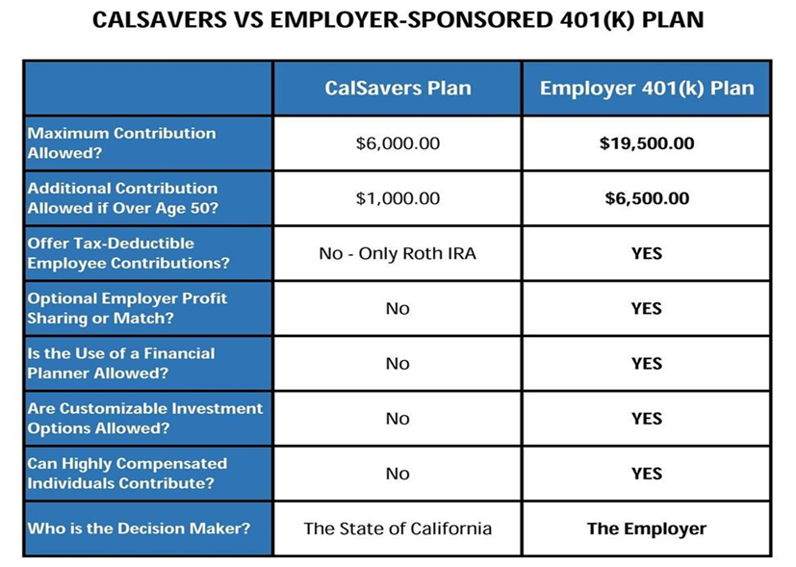
ALTERNATIVE OPTIONS TO SAVE
CalSavers is only required for employers who do not offer another type of retirement program for their employees.
Many employers offer some small ways to save by providing their employees with variable savings and retirement fund account. The standard alternative SEP, Simple IRA and 401(k) retirement programs, are still a viable option, with the most popular retirement product being an employer sponsored 401(k) savings plan.
The differences in CalSavers and an employer sponsored 401(k) plan can be observed in the comparison table below:

Slide 11
The Registration Deadline for employers with 5 or more employees is June 30,2022.
Register at CalSavers.com.
More than 100 employees |  |  | Extended to September 30, 2020 | Deadline Passed. Register Today.
More than 50 employees |  |  |  |  |  |  | Deadline Passed. Register Today.
5 or more employees
 | July 1, 2019 |  | June 30, 2020 |  | June 30, 2021 | June 30, 2021 |  | June 30, 2022 | June 30, 2022

Slide 12
OVERVIEW
CalSavers was put in place by legislation passed in 2016 requiring California employers that do not sponsor a retirement plan to expand access to a payroll-deduction retirement savings program and effectively bridging the gap for the millions of Californians who lack a way to save for retirement at their job.
The solution improves somewhat on the option to establish an individual IRA readily available to Californians since contributions will be made from payroll deductions, which has been proven to increase retirement savings. CalSavers has no employer fees and incurs no fiduciary liabilities other than the normal imposed cost’ to the employer since they will have to maintain a new payroll process to regularly remit contributions to the State.
Alternatives to CalSavers are plentiful and diverse and may offer so much more than a payroll deduction IRA to benefit both employers and their employees while virtually operating at no taxpayer expense, CalSavers is professionally managed by private sector financial firms with oversight from a public board chaired by the California State Treasurer.

Slide 13
EDUCATIONAL RESOURCES AND TOOLS FOR
BROKERS AND EMPLOYERS
ENROLL IN AN INTERACTIVE WEBINAR!
STILL HAVE QUESTIONS?
D
Brokers and employers can attend educational webinars to receive resources and instruction on how to implement the CalSavers retirement program by clicking here!
You can find several of the most frequently asked questions by brokers and employers or chat with an experienced client services team member. If needed, browse additional resources and look over program materials here.

Slide 14
EDUCATIONAL EMPLOYEE RESOURCES AND TOOLS
ENROLL IN AN INTERACTIVE WEBINAR!
NEED HELP DECIDING HOW MUCH TO SAVE?
NOT SURE WHICH INVESTMENT OPTION WORKS BEST?
D
Find a multilingual outreach team you can talk with, share resources and receive instruction on how to submit employee payroll contributions by clicking here!
​Calculate your potential savings by clicking here!
Take a look at the different investment options available to choose from by clicking here!

Slide 15
THANK YOU

