Slide 1

Humana Specialty Benefits

Slide 2


Humana Dental
We look different in the market…
But… Different is good!
National Carriers 5/172

Slide 3


Humana A Better Value
Benefits beyond the spreadsheet
No Participation Requirements.
3 Normal Cleanings Anytime
No Waits (Virgin 5+)
No ER Contribution to get
Employer Sponsored Rates.
4 Perio Cleanings Under Preventive
Free Onsite Dental Clinics
All Plans Unlimited
$0 Copay Tele-Dentistry
20 Hour min / Carve outs allowed
Back End Protection: Extended Annual Max
JET Issue Cases (24-72 Hours)
Physical & Digital ID cards
Front End Protection: Preventive Waived Rider
Instant Dental ID Cards
Passive PPO Network

Slide 4
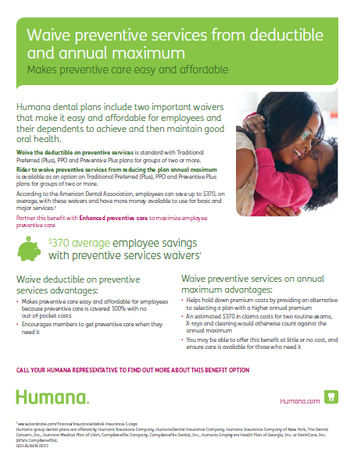
Humana Preventive waived
Preventive Waived Rider; Completely removes all preventive services from going against the annual maximum. (Including; if a member hits their max)
Front End Protection Day 1, Members receive their 3 cleanings, 4 perio cleanings, and x-ray services without any impact to the annual max.
Low cost / High Value: Rider costs 40 – 60 cents to add, but actuarially it’s more than a $500 boost to the annual max.

Slide 5
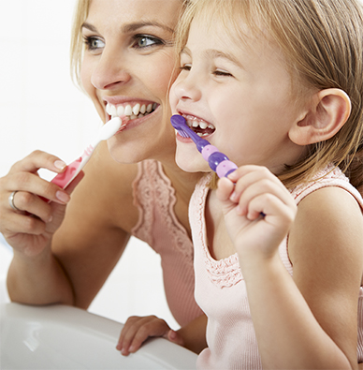


Humana Extended Max
NO need to delay care
NO paid claims thresholds
NO dollars to roll over or provider restrictions
NO need to track annual usage
Rollover Vs Extended Max | Rollover | Extended Max
Are all members covered? | X
Is coverage immediate? | X
Is the benefit unlimited for covered charges? | X
No qualification criteria | X

Slide 6
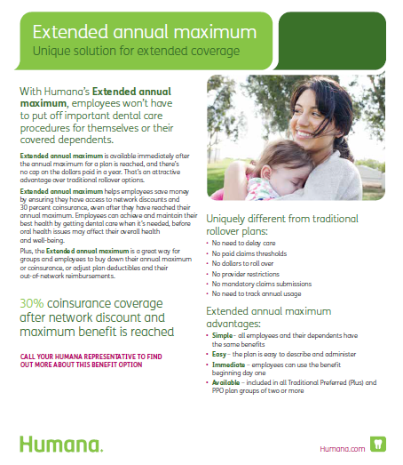
Humana Extended Max
Exclusive Extended Annual Maximum; 4th tier benefit: 30% unlimited co-insurance with no cap in dollars paid in a year.
Back End Protection: Rewards members who utilize their plan day 1, turns the annual max into a threshold, and makes all dental plan max’s UNLIMITED. Compare to Rollover which rewards members who don’t utilize their coverage.
Increased Value – for those who seek in-network providers – continuous network discounting.
Extended Max applies to Implant coverage For groups that elect the implant rider

Slide 7
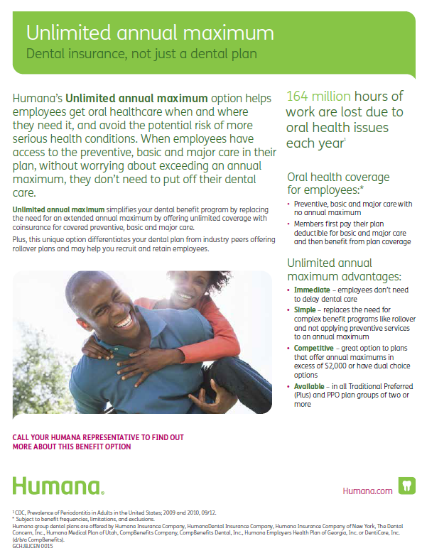
Humana Unlimited annual Max
Taking our unlimited coverage, a step further; Humana is the first carrier to offer an unlimited annual max in the marketplace.
Just like it sounds, Humana’s Unlimited annual max is truly that, unlimited coverage with no cap’s in dollars paid in a year and no lowering of co-insurance levels.
Orthodontia– is the only benefit that continues to have a max, as ortho has a lifetime maximum.

Slide 8
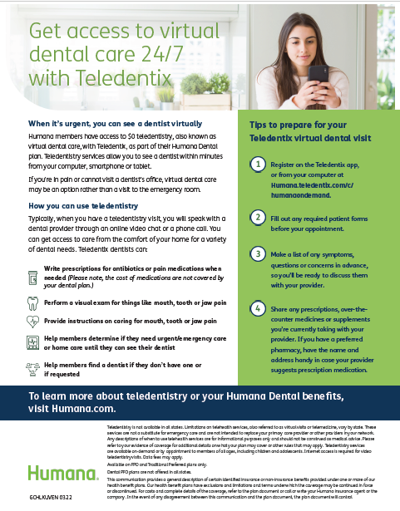
Humana Tele-Dentistry
$0 Co-Pay; available 24 hours a day 7 day’s a week virtual dental care through Tele-Dentix on your mobile device.
Prescription– Providing immediate prescriptions for antibiotics or pain medications as needed
Result– Reduction in ER visits for your self-funded clients

Slide 9
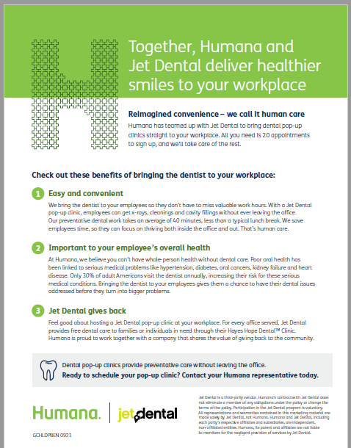
Humana On-Site Dental clinic
Onsite dental clinic through partnership with JET DENTAL; Bring the dentist to your clients at no cost to the employer.
Preventive dentistry– Dental services, include cleanings both normal and perio, x-rays and even small fillings at no cost to the employee.
Perfect for your larger clients– Only 25 appointments per day of onsite needed to qualify

Slide 10
Humana The better value
The better value option
in the market
Humana’s TRP 100/80/50
$1000 annual max plan
+ waived preventive
and extended max
Here’s why….

Slide 11

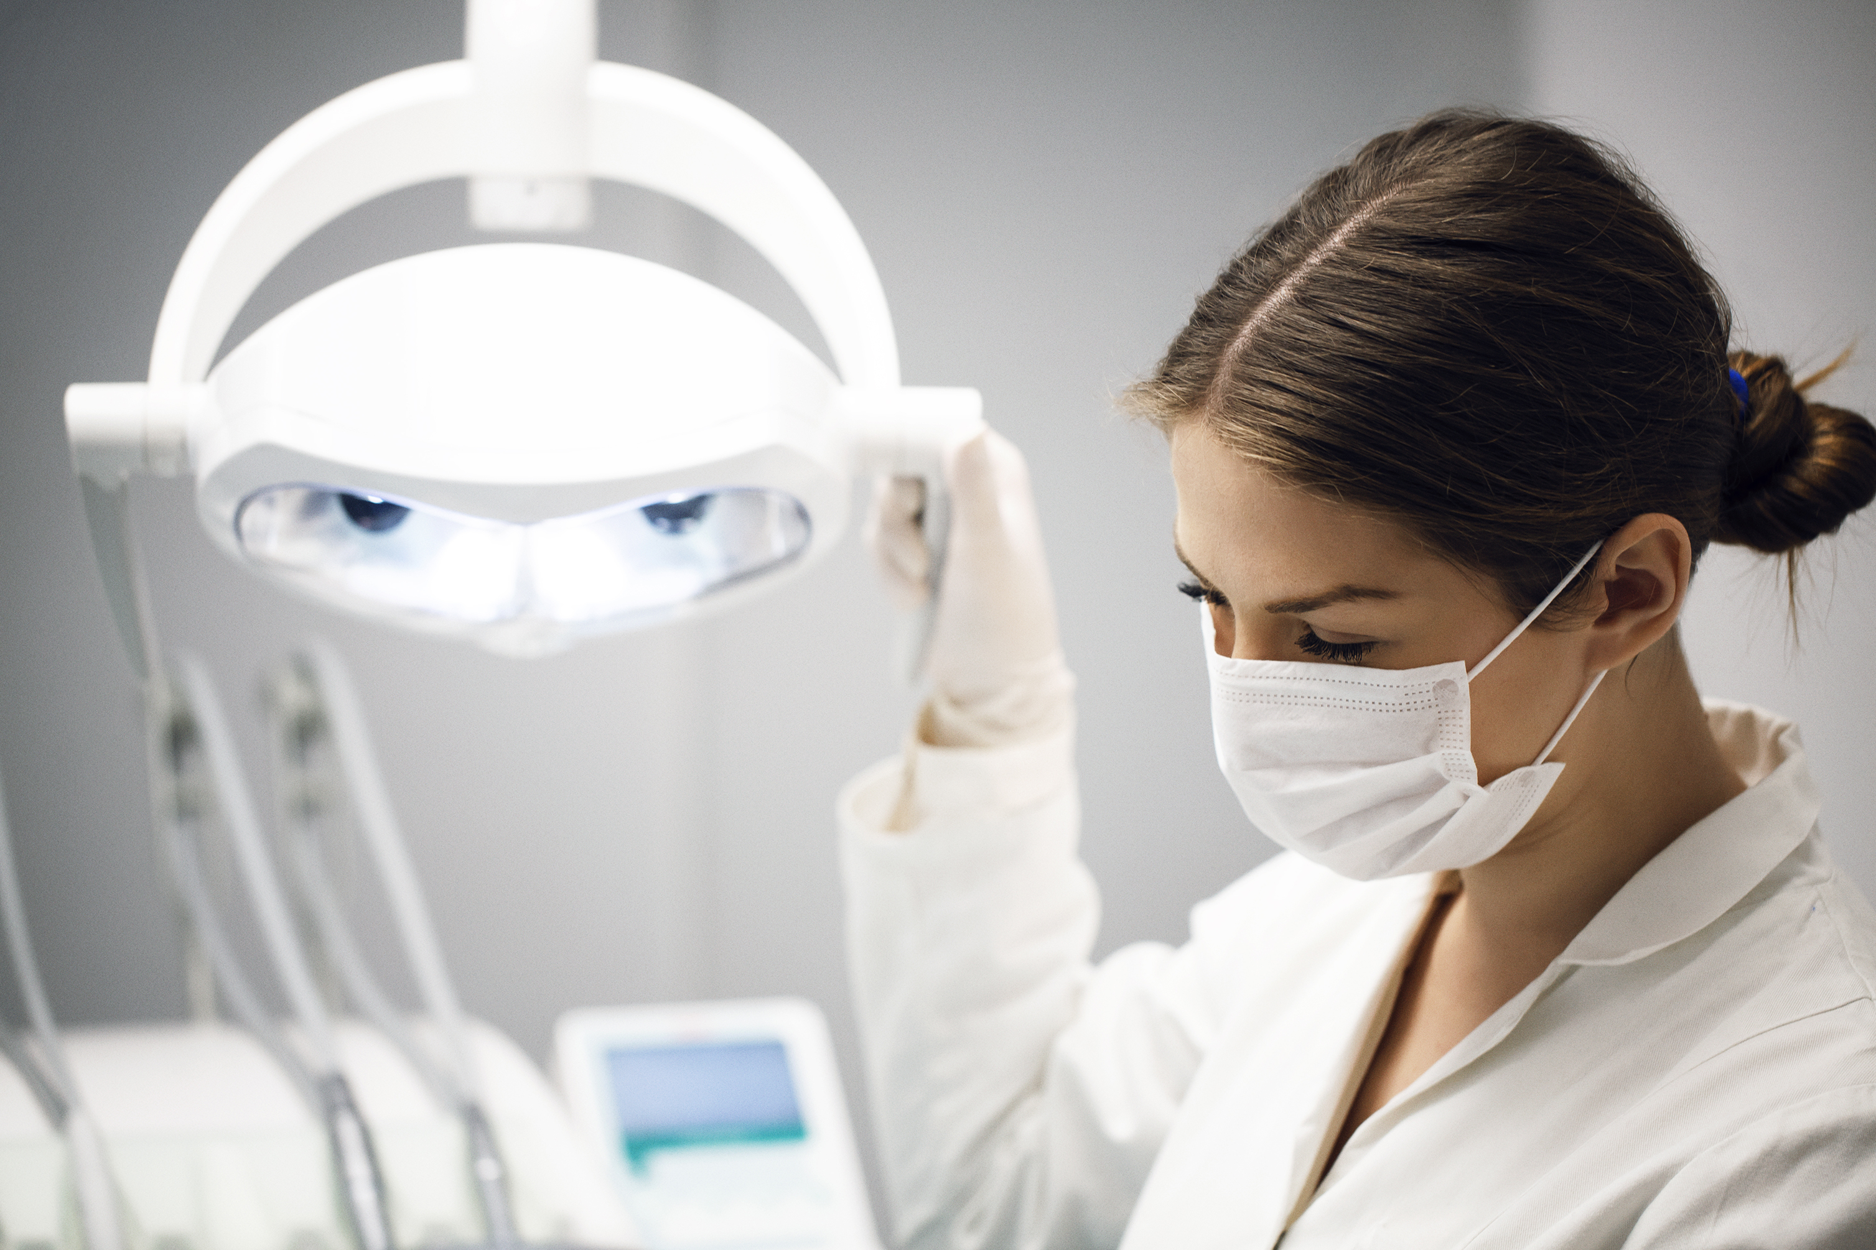
Humana Example
Meet Jenny!
Were going to take a quick deep dive on Jenny’s experience using Humana’s best value 1k dental plan vs a 1k plan from the competition
Jenny goes in for 2 cleanings– @ $94 x 2
Preventive Exam – @ $54 x 2
Annual Xray’s – @ $100
Total Annual Preventive costs, “Competition” (2 Cleanings) – $396
Total Annual Preventive costs with Humana (3 Cleanings) – $544

Slide 12
Humana Example
Jenny then needs:
Single filling $187 payable at 80% or $150.00 applied to the annual max
Crown $1247 payable at 50% or $623.50 applied to annual max
Average Carrier
(2 cleanings)
$396 + $150 + $623.50 = $1169.50 –
EXCEEDS MAX BY $169.50
Humana
Best Value: (3 cleanings)
With waiver of PREV rider
$150 + $623.50 = $773.50
You would need at minimum a $1500 max from a normal carrier to compete with Humana’s 1k best value option. This example gets even more dramatic when additional services like implants or multiple major expenses are incurred as Humana’s 1k benefit is truly an unlimited benefit.

Slide 13

Humana Vision

Slide 14


Humana Vision
Simple guidelines that match our Dental
Easy ONLINE options for frames, scripts and glasses
·Broad spectrum of frame allowances; 100, 130, 150, 160 and 200 dollar allowances
One of the nations largest networks -INSIGHT, a blend of Humana’s and Eye Med’s nationwide networks.
2% Dental bundling discount.
$4 vs $5 Premium Story

Slide 15
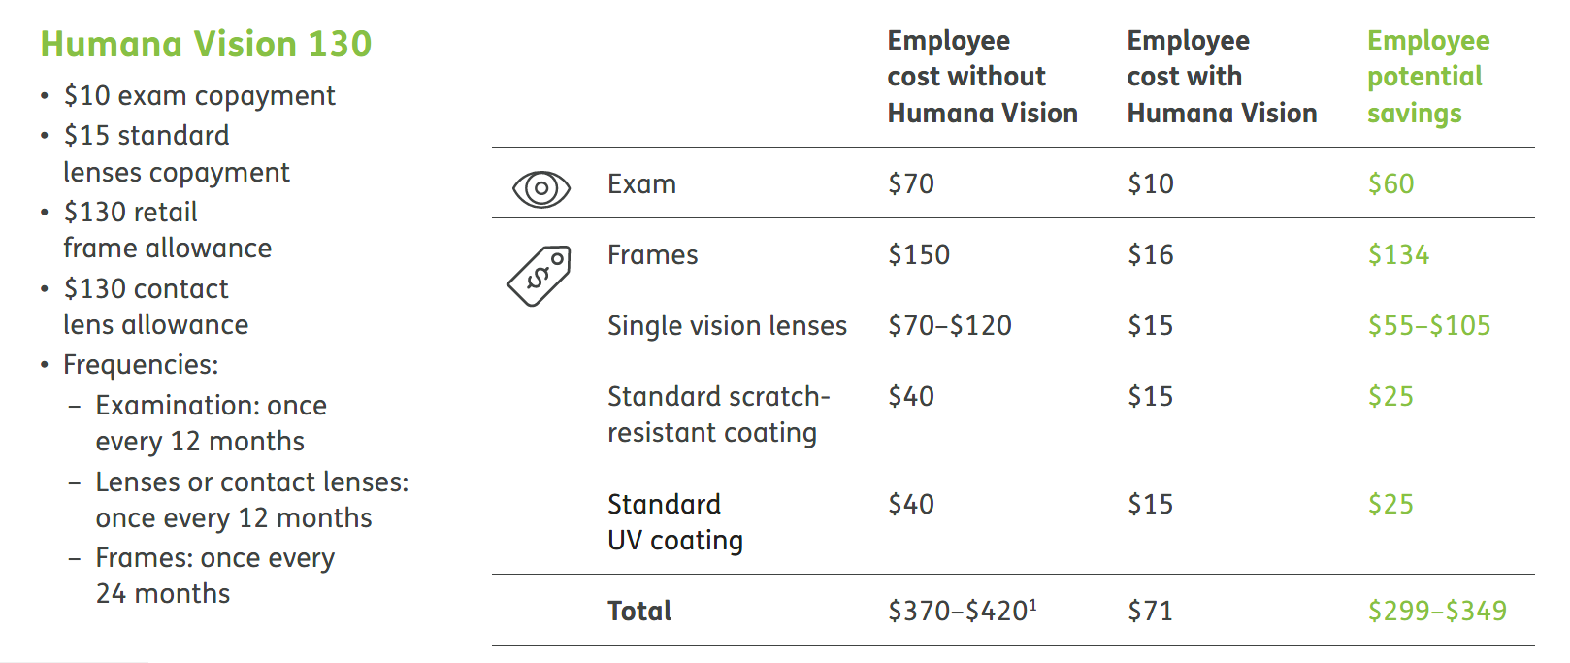
Humana Vision
Humana Vision

Slide 16

Humana Basic Life

Slide 17
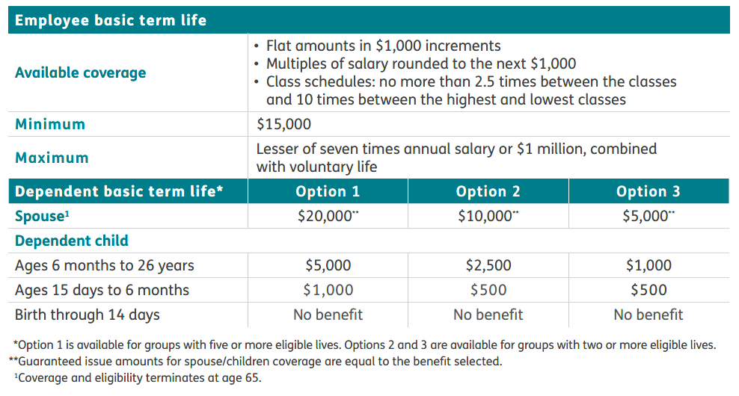
Humana Basic Life
Basic Life
Life Rate Match
Groups 25 + where we match CURRENT / pre-renewal rates.
Adding life is worth 2% off the dental line.
3 Schedules available
Convertible day 1

Slide 18
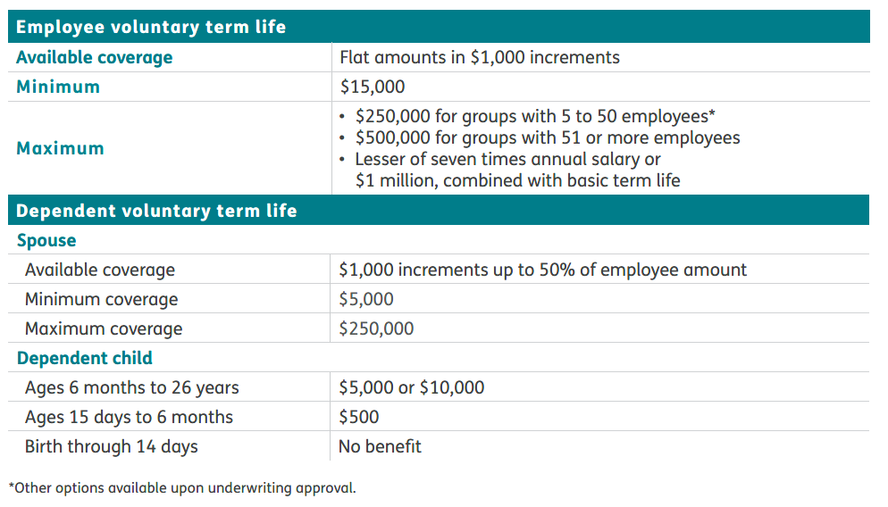
Humana
The Dental Difference
Humana Voluntary life
Voluntary Life
Grandfathering available for groups interested in replacing current coverage.
Adding Vol life is worth 2% off the dental line.
Special vol life increase program of 25k GI for EE’s everytime vol life renews.

Slide 19
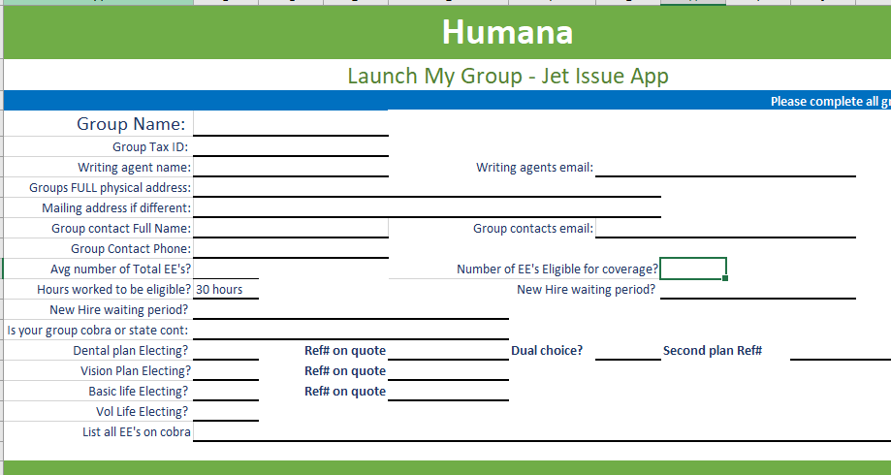
Humana LAUNCH MY GROUP – JET ISSUE
Voluntary Life
Basic Life
Humana’s proprietary Jet Issue enrollment system, with some of the fastest case processing available.
Super simplified group app with no WET signatures.
Simplified census, paper apps or use both!
Case processing in as little as 1 hour, guaranteed within 72 hours. Usual same day turnaround.
Signatures collected via email at time of group issue via Adobe Verisign.
Dental ID’s issued within hours and can be sent as a report directly to your group.
Test bill that can be used to audit available immediately

Slide 20

Get a quote today
Please send your quote requests to:
jhaus1@humana.com

Slide 21


